Slide 2
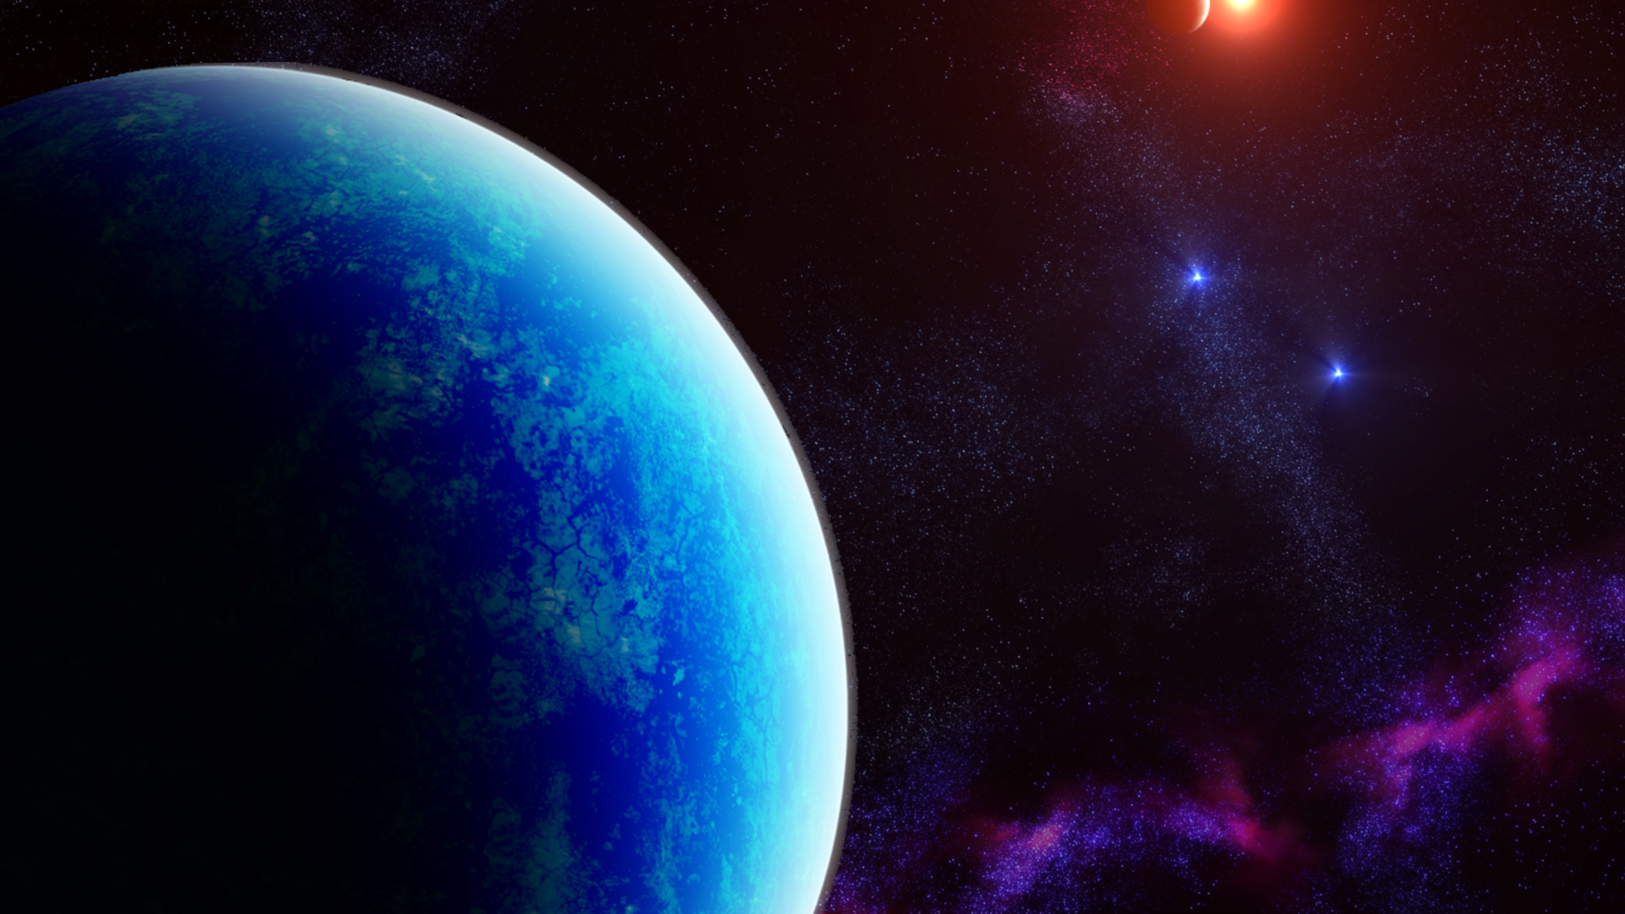

Hi, Saturn Here !
Have you ever wonder how can we send and receive information through space?

Slide 3
Are other planets having similar issues as our? How can I know?
Why I would want to know?
Well, let’s go find it…

Slide 5
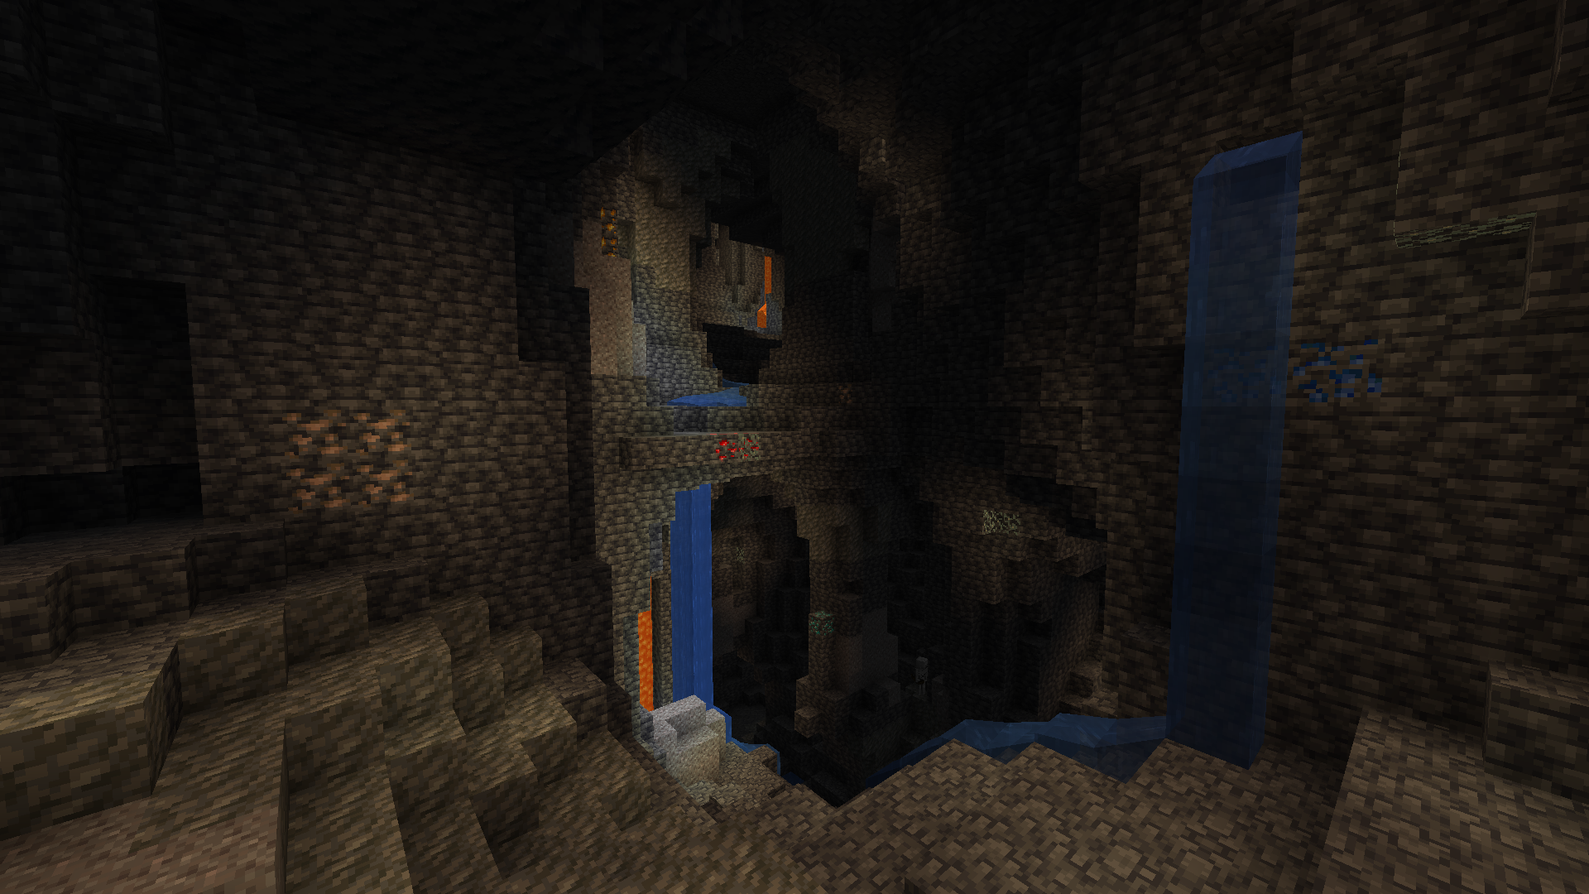


Slide 6
Earthquakes are catastrophes that occur in our world when we less expect them.
And, even if we can’t see them, we can feel them deeply.
So, would this still be a problem if a just bought a house in mars?

Slide 7

In order to answer that, we present to you

Slide 8
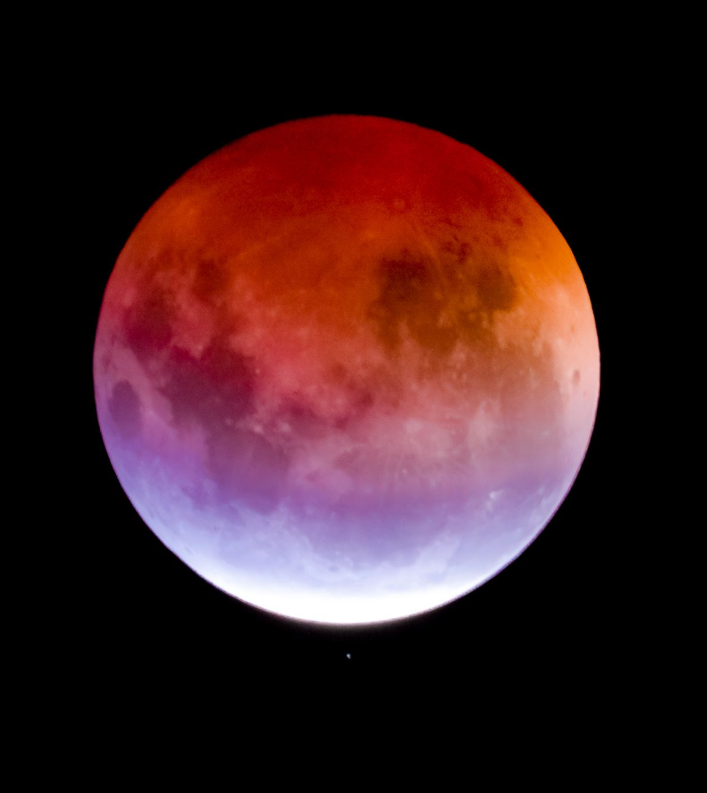
Pero que es E.T.??
Extraterrestrial Tremorsense is a user friendly tool that we make with the hope it help with the understanding of seismic events and their impredicibility
One of the main benefits of this project is to detect in advance earthquakes/earthquakes that could affect research missions in space with robots, as well as to predict the frequency that these earthquakes/earthquakes could generate on a larger or smaller scale.

Slide 9
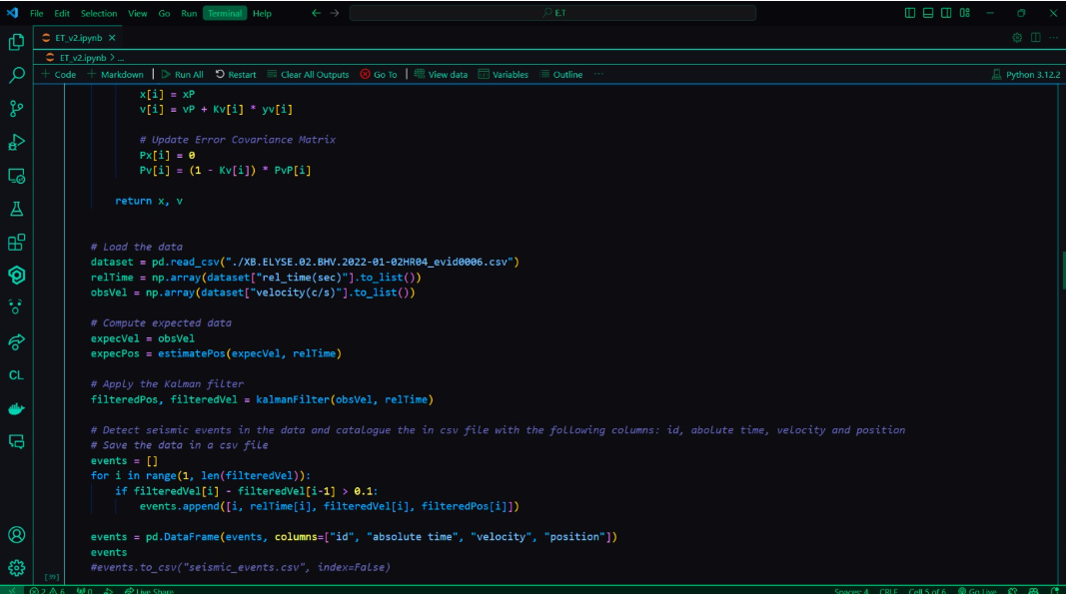
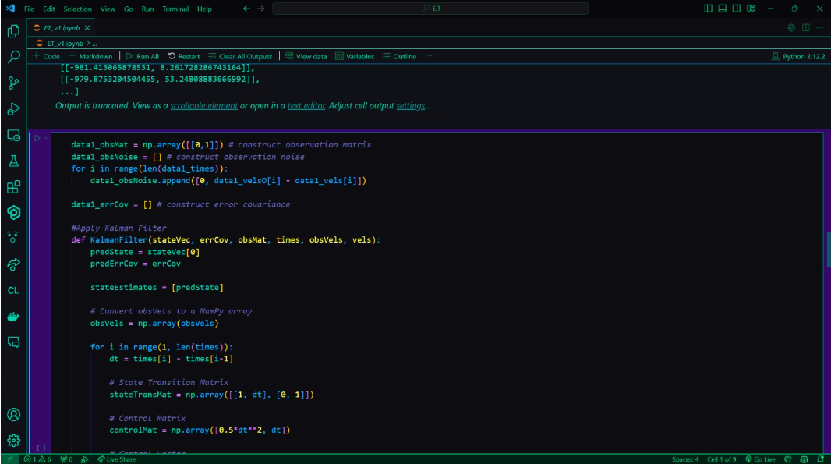
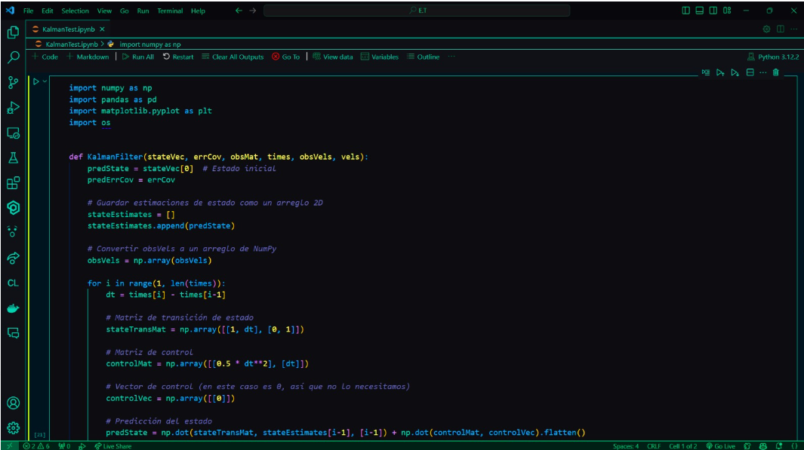
Three Different Version of the Kalman Filter

Slide 10
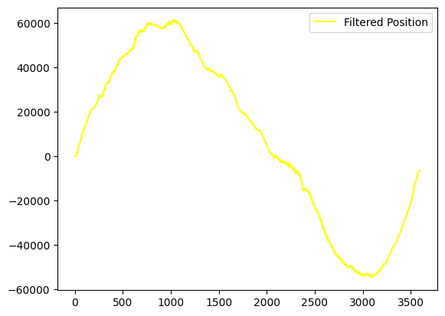
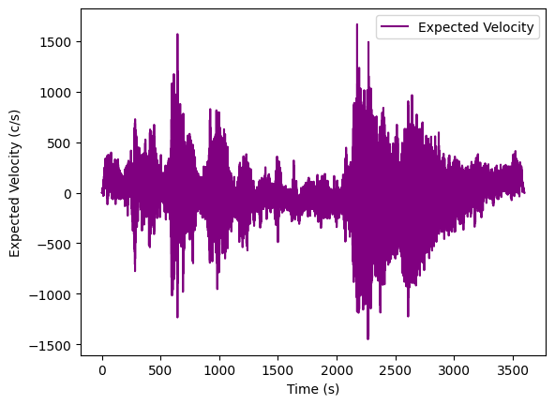
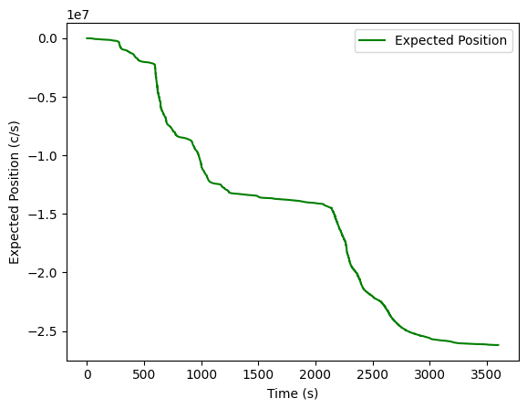
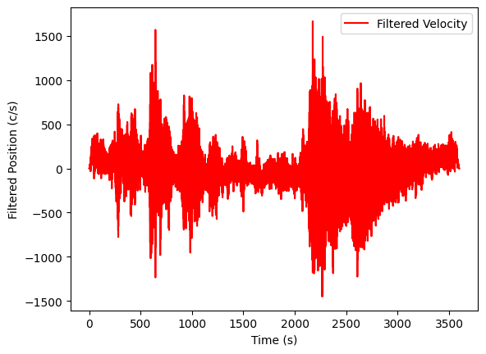
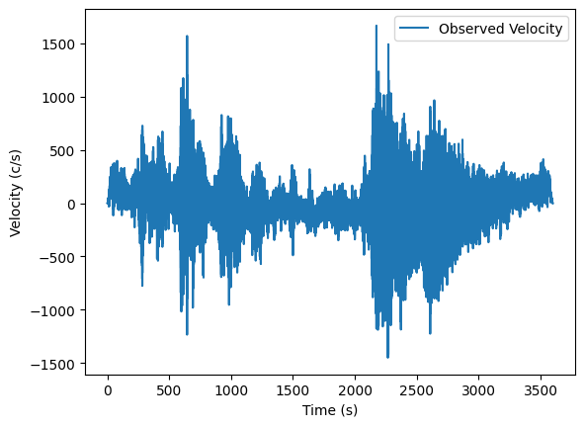
Results of the analysis
Of 1 .CSV file:

Slide 11

Thanks for your Time

